Slide 1
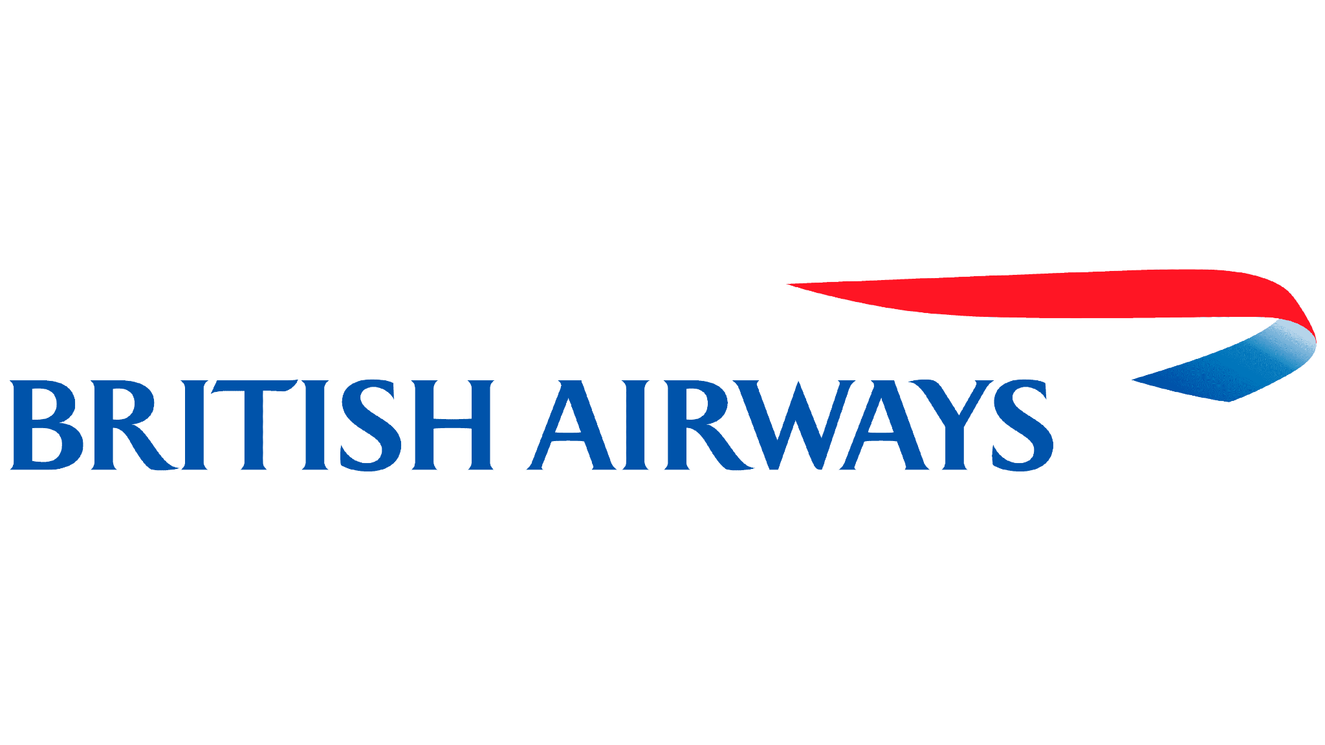
Customer Reviews
Sentiment Analysis

Slide 2
Analysis Approach
A total of 1000 customer reviews in the text form were given.
Unnecessary words, punctuation marks, special characters and numbers from the raw text were removed.
To derive the overall sentiment we used 3 techniques:
Classification using Key-Words: We defined a set of negative words and checked if the text of the review contains those words, if Yes, the review was classified as 1 (negative), else it was classified as 0 (positive).
Clustering using KMeans: We used a predefined ML algorithm KMeans and bifurcated the reviews into class 0 and class 1.
VADER Sentiment Analysis: We applied a Lexicon based sentiment analysis tool and predicted the sentiments of the reviews based on the Polarity Score.

Slide 3
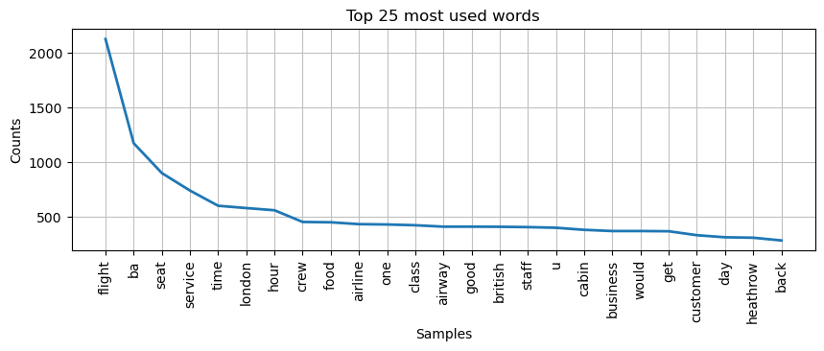
Important Words: After cleaning the text these were the top 25 most used words by customers

Slide 4
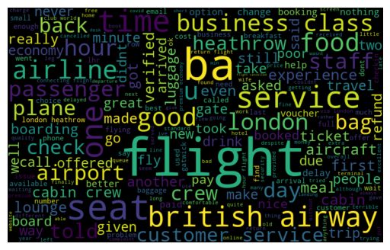
Important Words: Here is a word cloud representation of most used words

Slide 5
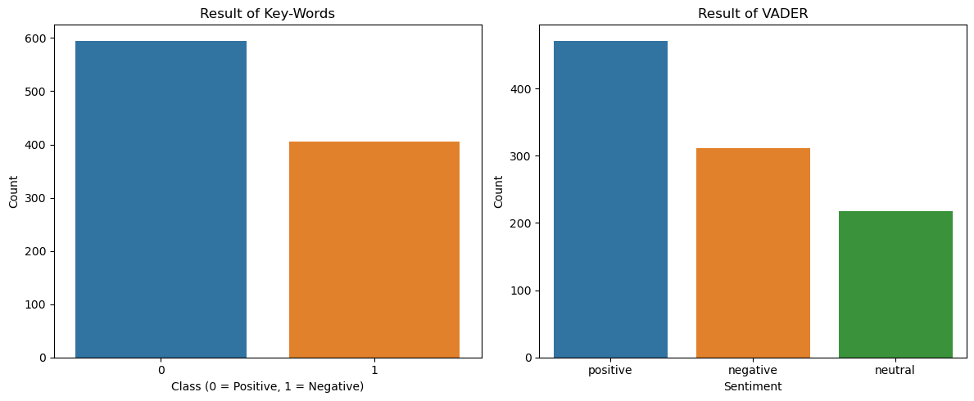
Sentiment Analysis

Slide 6
Conclusion
Based on Key-Words and VADER approach we find out that even though in total the customer reviews are positive, there’s a large chunk of customers who are disappointed in service. We must identify the problem areas and take decisions to improve the services.

